Slide 1
Final Project Update
Brian Slobotsky -- GEOG788P

Slide 2
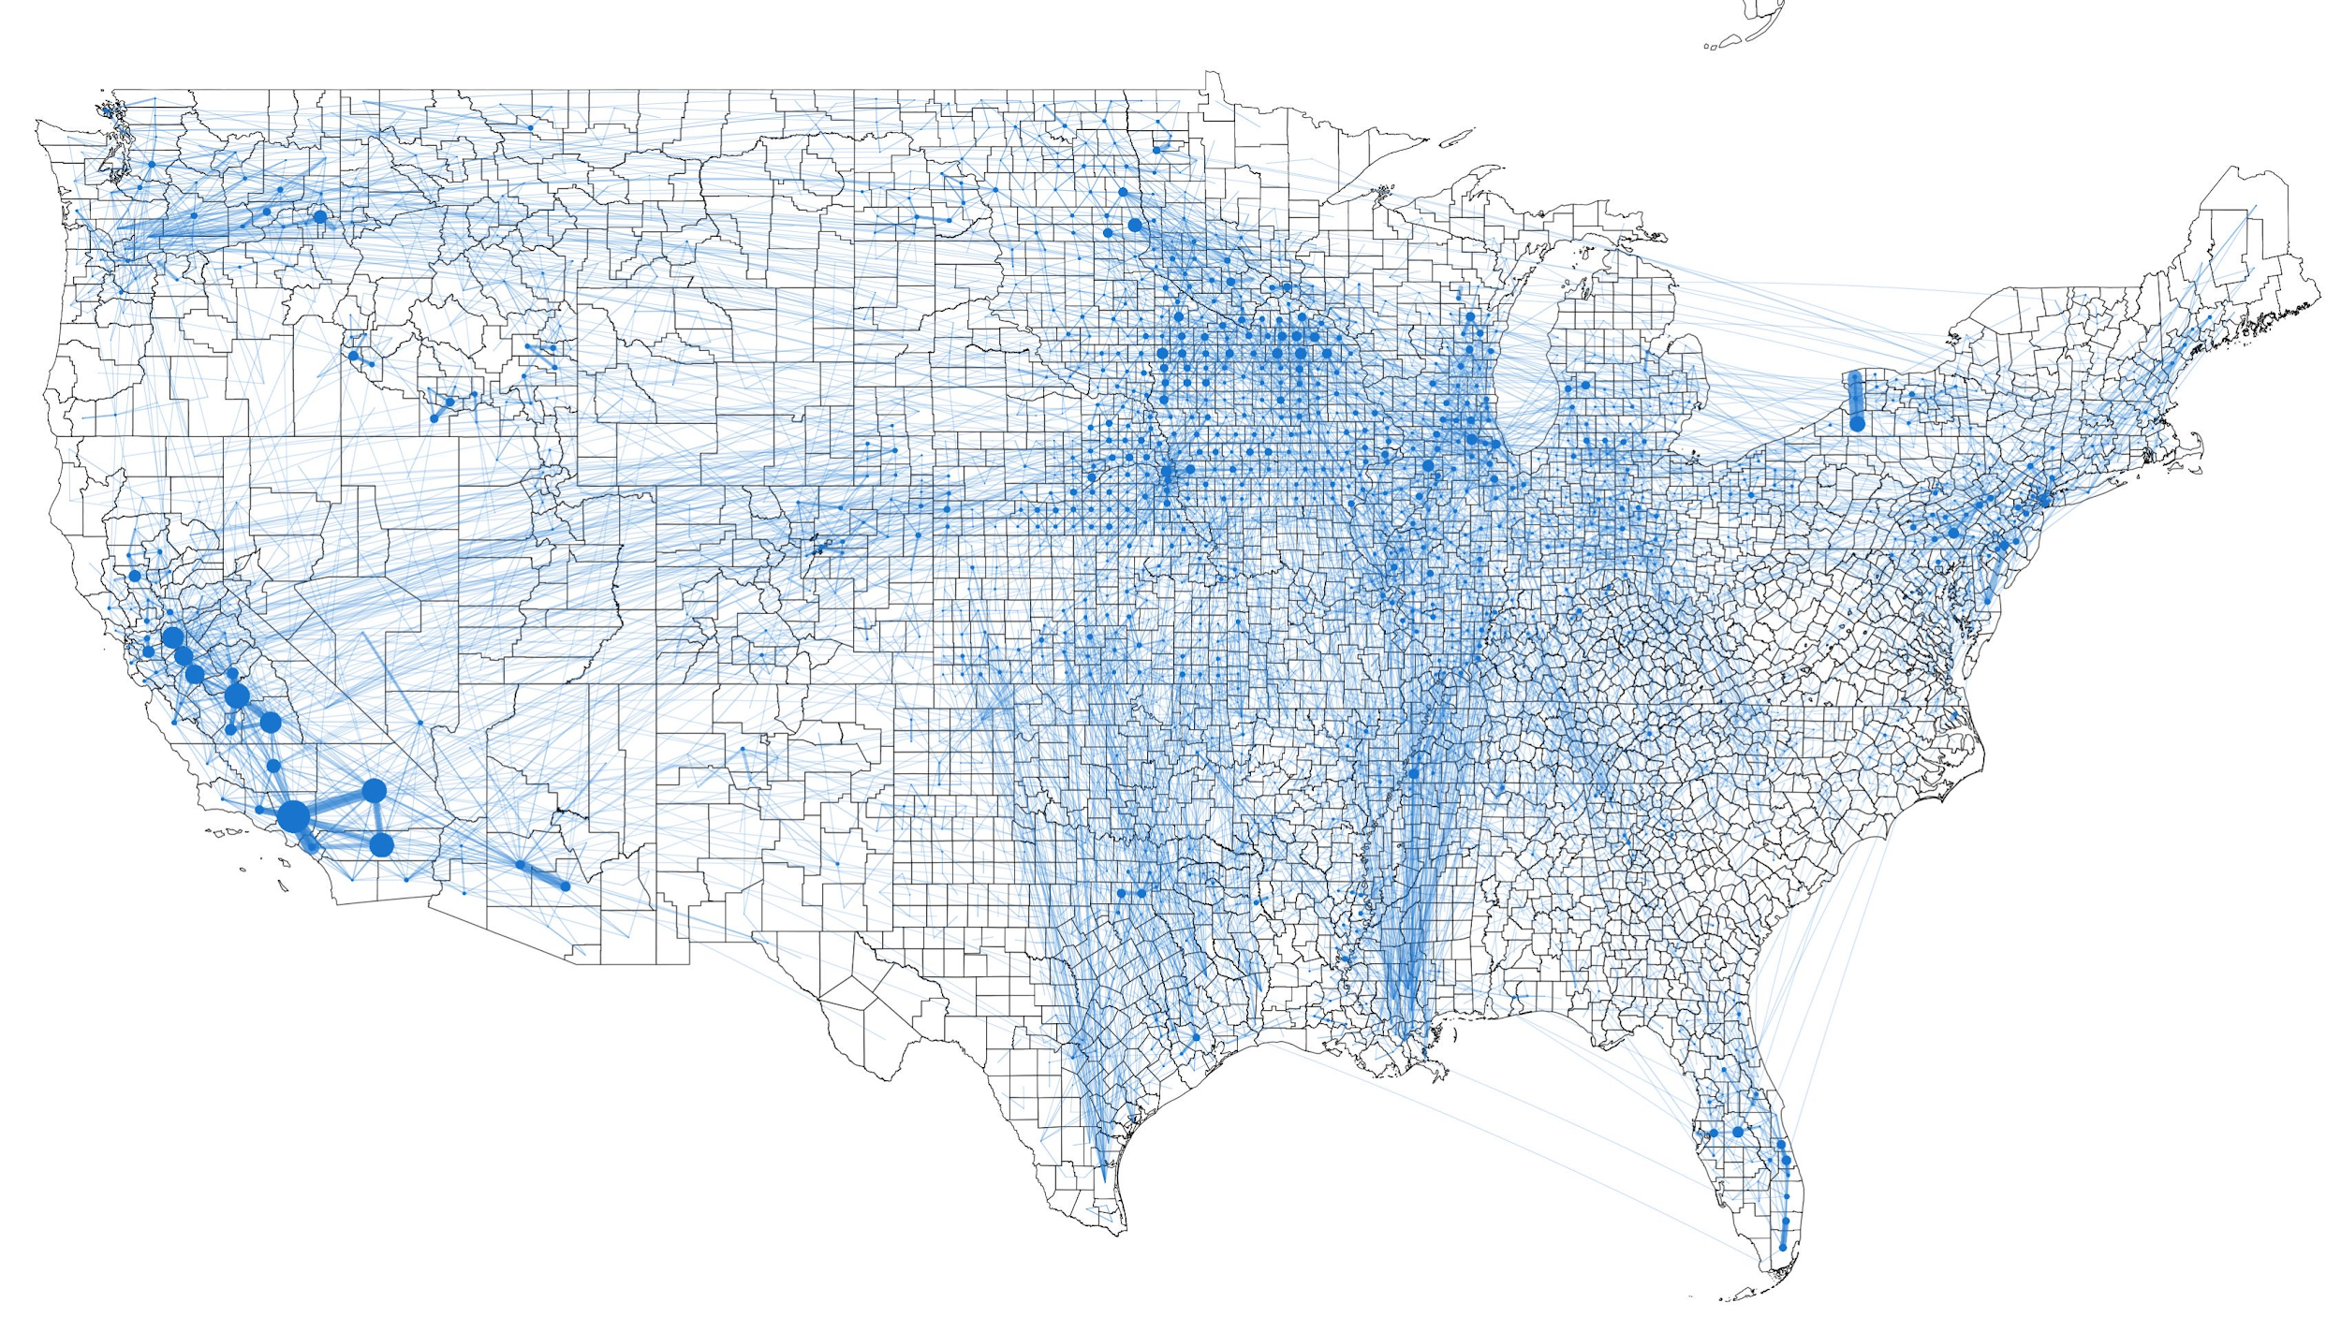
"Food flows between counties in the United States": Visualization and Analysis

Slide 3
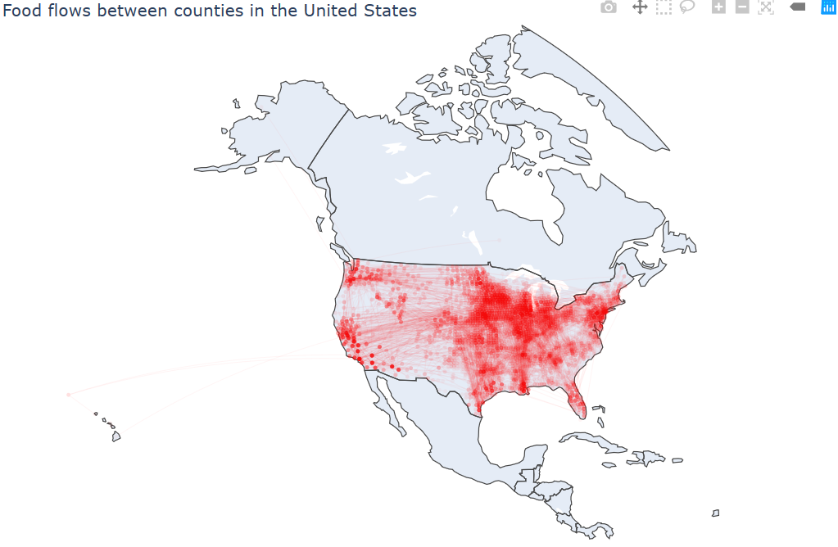
"Food flows between counties in the United States": Visualization and Analysis

Slide 4
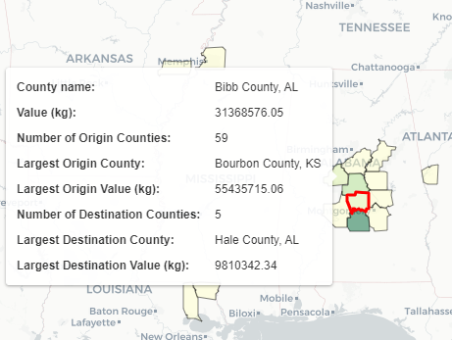
Visualization
Plotly
Interactive version of the paper’s static map
Shows only top 10,000 flows (out of more than 160,000) to improve performance (6.278 mb)
Lines vary in width and opacity by volume, markers vary by size
Folium
User interface to narrow the map to a single county
User inputs → .geojson file → folium map in HTML file
Hover, layer control, and search
Count of counties, largest origin and destination

Slide 5
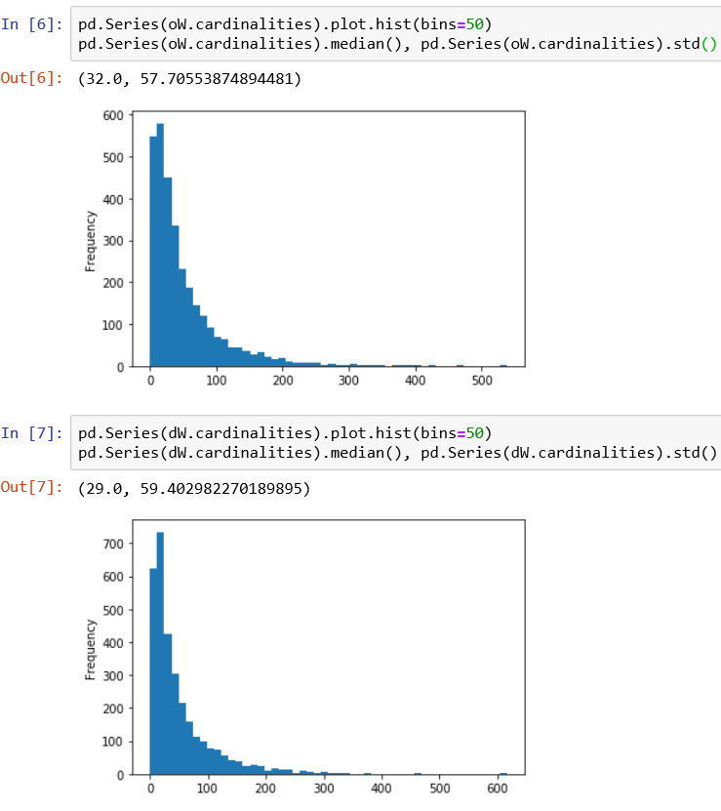
Analysis
Flow-based spatial weight matrices
Islands (destination-only counties)
Same distribution of county cardinalities
Mean = 51.36 (flows/counties)
Destination has a slightly larger standard deviation & smaller median
Spatial variation differs
KNN spatial weight
30 nearest neighbors

Slide 6
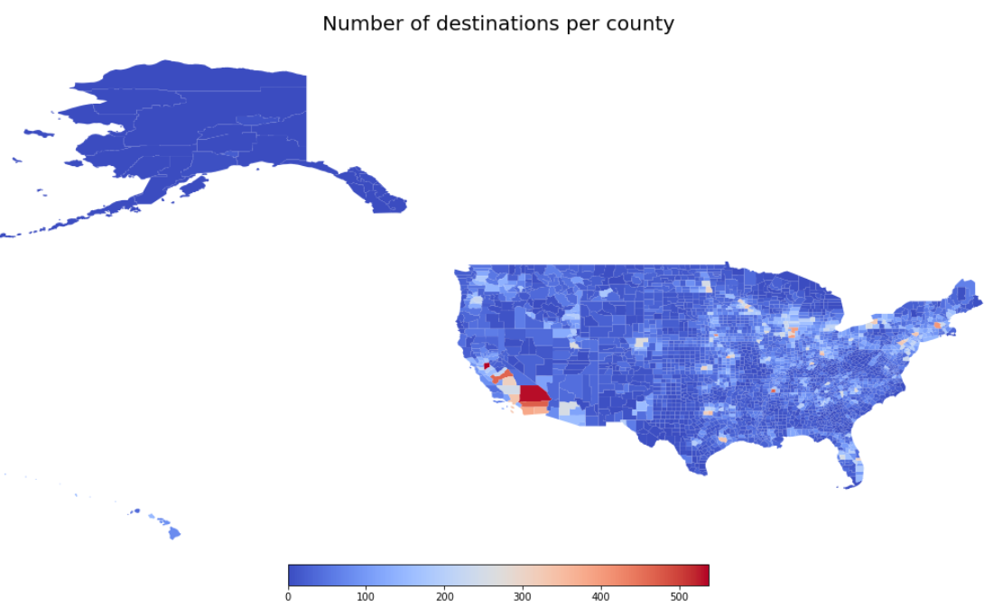

Slide 7
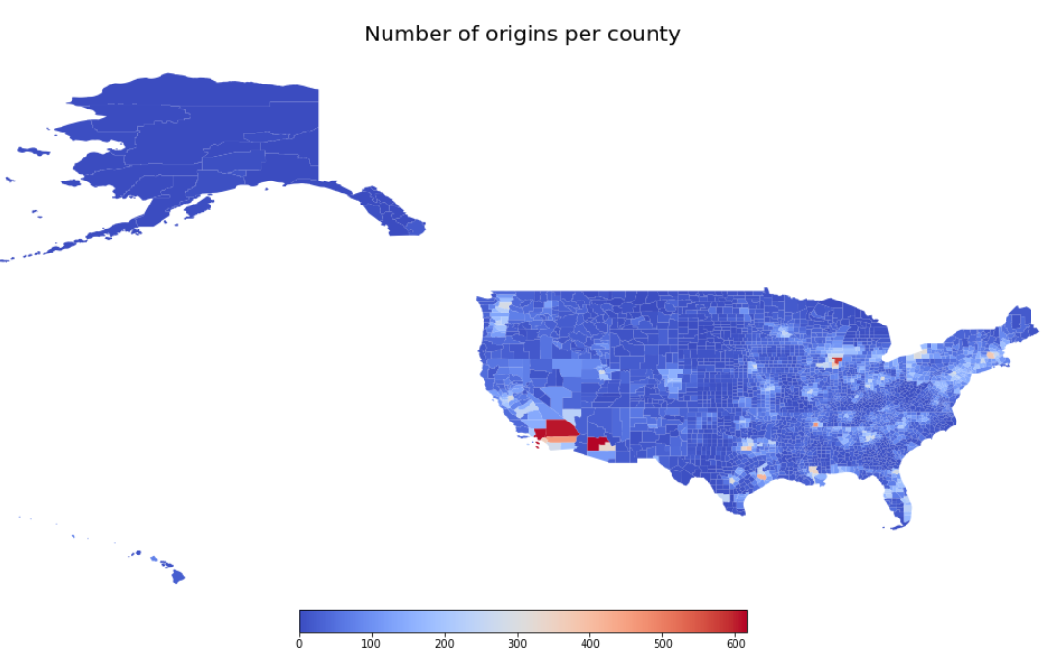

Slide 8
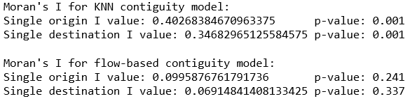
Analysis
Spatial autocorrelation of the total volume variable
Four tests
Flow-based contiguity model and kernel contiguity model
Single origin and single destination
Global spatial autocorrelation:
Positive spatial autocorrelation (clustering) among adjacent counties, no statistically significant spatial* autocorrelation using flow relationships

Slide 9
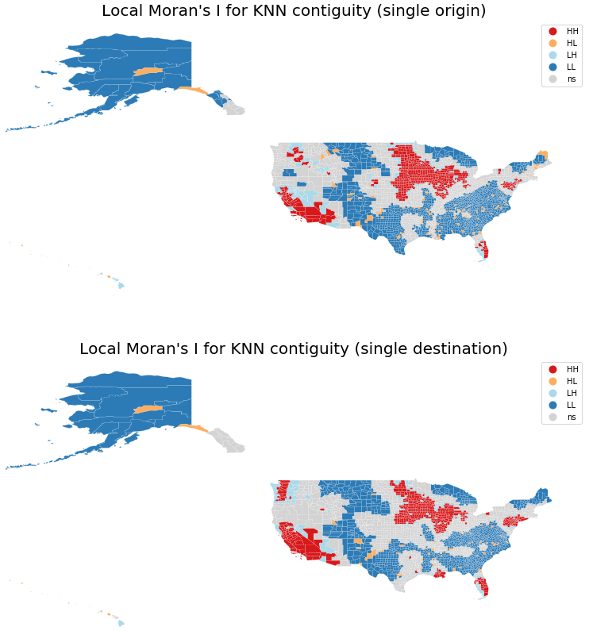
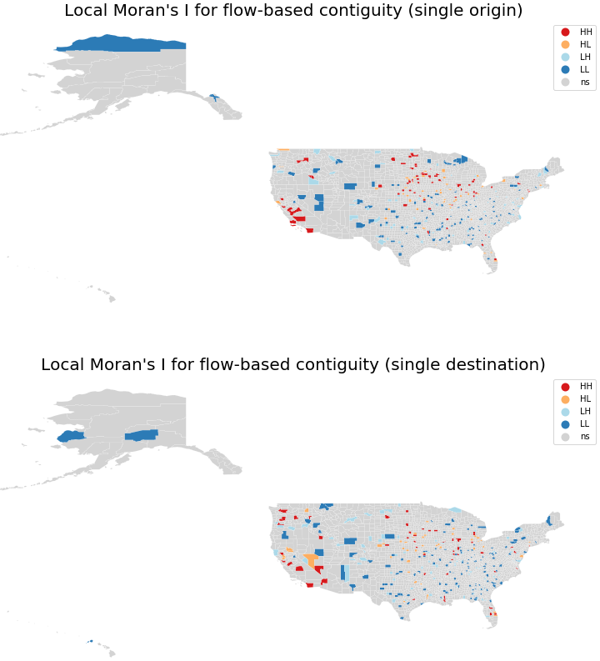

Slide 10
Analysis
Local spatial autocorrelation
Large clusters of similar values in the KNN models
The two flow direction maps are similar
The flow-based maps appear to show "dispersed clusters" since contiguity is not defined by adjacency
This allows for a clearer view of high and low value clusters and outliers in the original paper's flow model, and displays trends similar to the cardinality maps

Slide 11
Conclusions
Origin and destination counts per county have similar distributions numerically, but not spatially.
Total value (for both flow directions) has positive spatial autocorrelation with a k-nearest neighbor conceptualization of contiguity.
There is no statistically significant spatial* autocorrelation using flow relationships as the conceptualization of contiguity.
There are higher cardinalities and local clusters of high values in Midwest origin counties relative to Midwest destination counties; the same can be said when comparing populous destination counties to populous origin counties.

